Slide 1
Capitalism and Democracy

Slide 2
What is Capitalism?
Capitalism is a market based system. Economic decisions are primarily made by private individuals, who invest money, start businesses and employ other individuals. They are motivated economic self-interest and respond to market prices.
There is a role of government, but it is limited (defending property rights, maintaining a currency, arbitrating disputes)

Slide 3
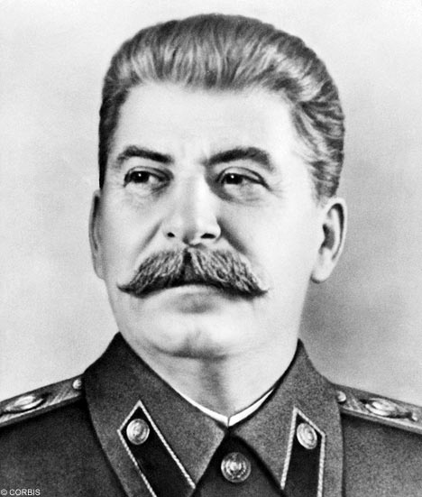
What is a command and control economy?
In a command and control economy, the government runs the economy- it owns the businesses, it sets the prices, it determines where workers will work and decides how much will be produced.

Slide 4
“Welfare Capitalism”
Most advanced industrial democracies are neither pure market systems nor command and control. They are market based systems with a large role for the state in regulating the economy, promoting some businesses and maintaining a safety net. Public investments in infrastructure (roads, energy, dams etc.) and education are common.

Slide 5
What is democracy?
Democracy is not direct democracy (rule by the people) but representative democracy (the people elect those who rule them).
It involves civil liberties, rule of law, political equality and competitive elections.

Slide 6
What is authoritarianism?
Authoritarianism is where the government is not elected, and does not guarantee basic rights.
There are many different forms: military , single-party, kings, theocracies, etc.

Slide 7
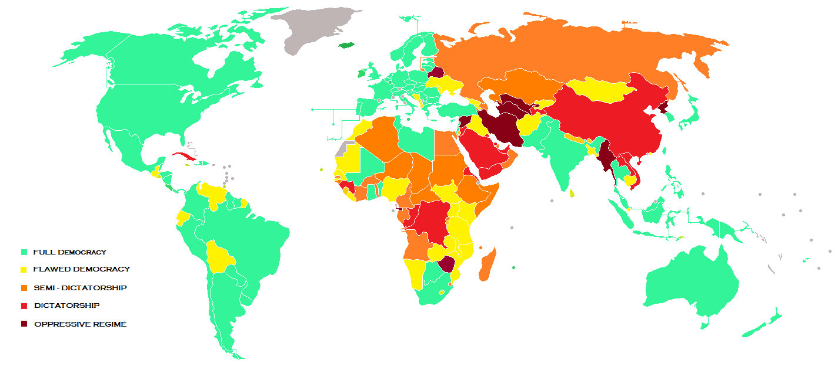

Slide 8
The Question: Is there a relationship between being capitalist and being democratic?
In U.S., we are both capitalist and democratic, but is this a necessary or even likely relationship? Can a country be democratic and command control? Can a country be a capitalist dictatorship?

Slide 9

Reasons why capitalism and democracy might go together
1. Both are based on individual choice. Voting for a representative bears a similarity to how consumers “vote” for which product they want.

Slide 10
Capitalism and democracy together: #2
2. Capitalism puts power in the hands of societal actors. This gives society a chance to challenge dictators and advocate for more rights.

Slide 11
Capitalism and democracy together:
#3
Capitalism promotes wealth, and as countries become wealthier, they also become more democratic (due to growth of middle class, spread of education).

Slide 12
Wealth and democracy
Rich countries
( US, Japan, Nearly all democratic
European countries)
Middle income
countries (Mexico, Partly democratic
Iran, Indonesia)
Low income countries
(Burkina Faso, Haiti, Mostly authoritarian, some
Myanmar) democracy

Slide 13
What are the exceptions?
What is it about rich countries like Saudi Arabia or United Arab Emirates that allow dictatorship to remain?
Why did a poor country like India remain democratic?

